Slide 1
Fresh detect
Ensuring quality and safety

Slide 2

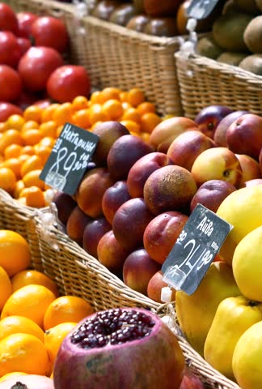
introduction
Fresh Detect is an innovative technology that ensures quality and safety of fruits and vegetables and agriculture products. By using advanced sensors and algorithms, Fresh Detect can accurately detect and monitor various parameters such as ripeness, firmness, and contamination levels. This helps farmers, distributors, and consumers to make informed decisions about the produce they handle and consume.

Slide 3
Benefits of Fresh Detect
Fresh Detect offers several benefits to the agricultural industry.
It enables farmers to optimize harvesting and storage conditions, reducing waste and losses. Distributors can ensure that only high-quality produce reaches the market, improving customer satisfaction and reducing the risk of foodborne illnesses.
Consumers can have peace of mind knowing that the fruits and vegetables they buy are safe and fresh.

Slide 4
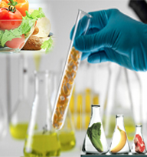
How Fresh Detect Works
Fresh Detect utilizes non-destructive testing methods to assess the quality and safety of fruits and vegetables.
It measures parameters such as temperature , humidity texture,gas concentration, and chemical composition using sensors.
These measurements are then analyzed by sophisticated algorithms that provide real-time insights. The technology can be integrated into existing production and distribution systems, offering a seamless and efficient solution.

Slide 5

Fresh Detect in Action
Experience the power of Fresh Detect in action.
Watch as our technology efficiently sorts and grades fruits and vegetables based on their quality and safety parameters there will no wastage of fruits and vegetables and no consumption of spoilled fruits or vegetables.
The agriculture sector will be so benifited a lot as lot of farmers do not have awareness of fruit life span it maintaniess and etc this system helps them to timiley board the products
Discover the future of fresh produce with Fresh Detect.

Slide 6
Future Developments

